Slide 1
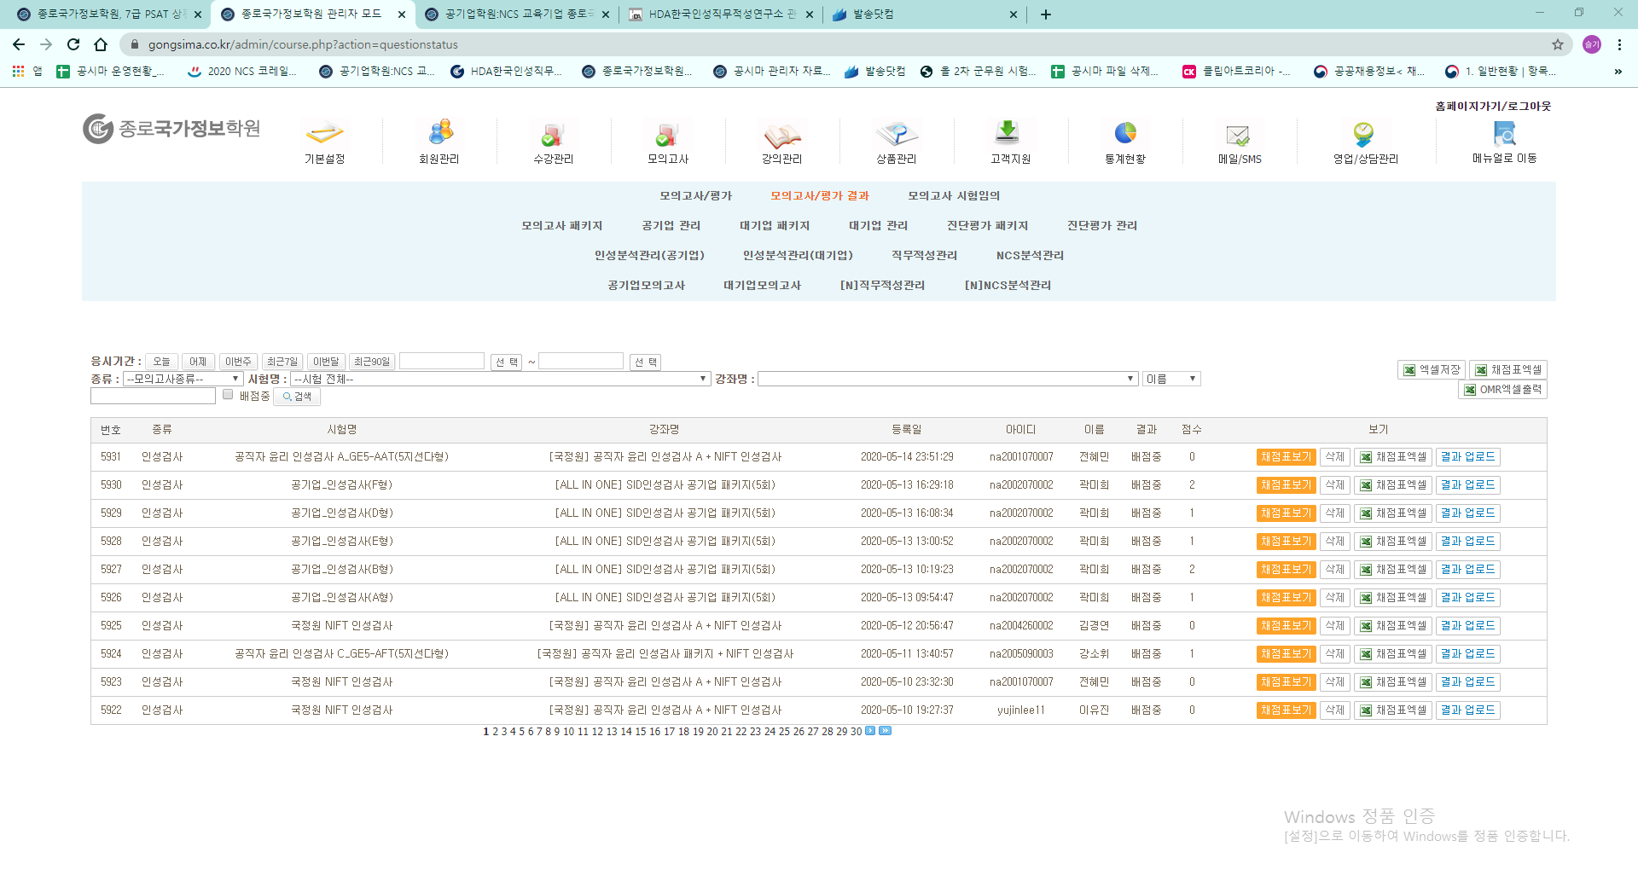
How to take a personality test
The personality test is Gongshima and the Korea Institute of Human Aptitude, and you need to
manage a total of 2 pages. First of all, you can go to [Homepage >Admin Page>Mock Tests>
Mock Tests/Evaluation Results].
1번
2번

Slide 2
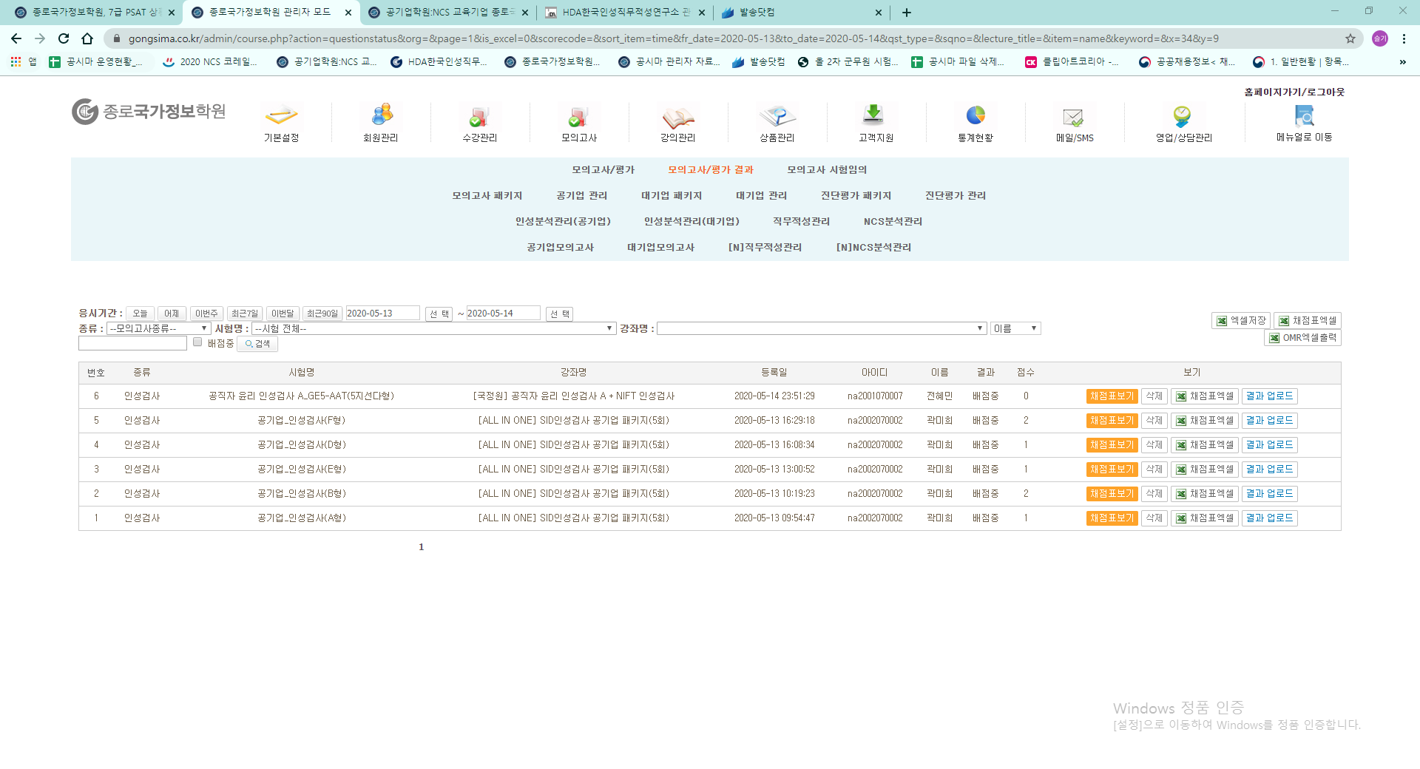
It will make inquiries from yesterday to today's date.

Slide 3
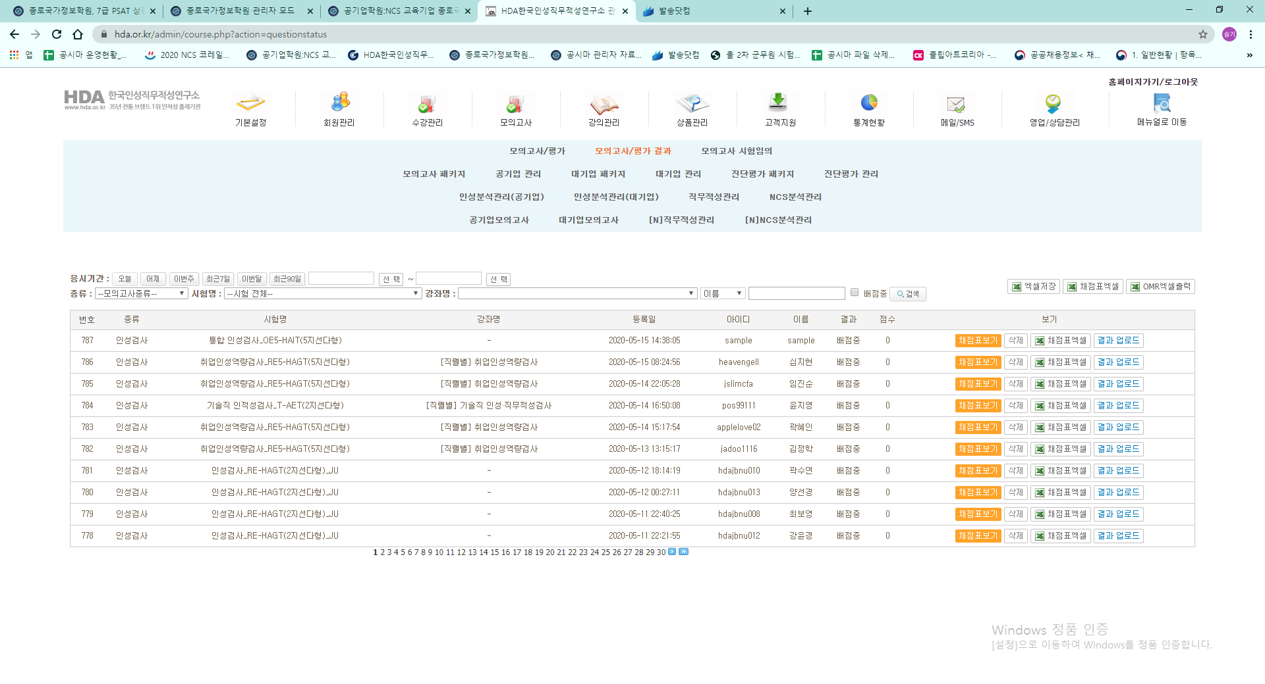
[1. Personality test result processing program _v2.0] When using Excel
1. If it is a public company on the Gongshima website
2. All Korean Aptitude Institute Exams Included

Slide 4
OMR Excel Output

Slide 5
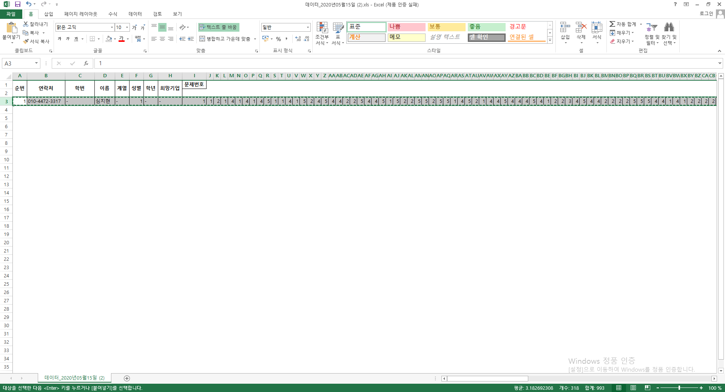
Copying a full column

Slide 6
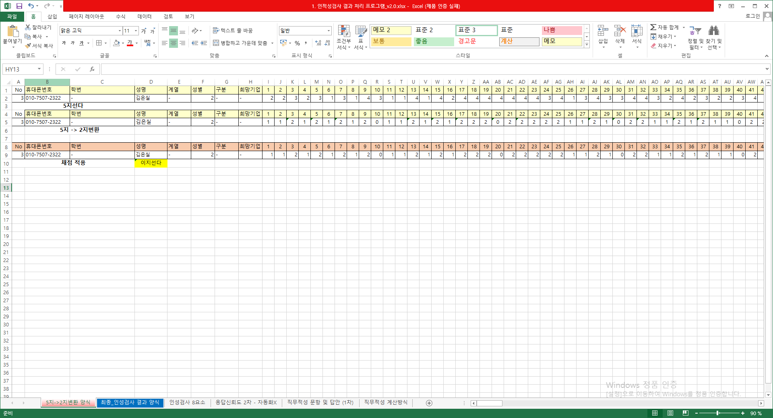
[1. Personality Test Result Processing Program _v2.0] Open Excel File
Paste the value into the 5-choice column
5-choice conversion to 2-choice
Convert 5 to 2

Slide 7
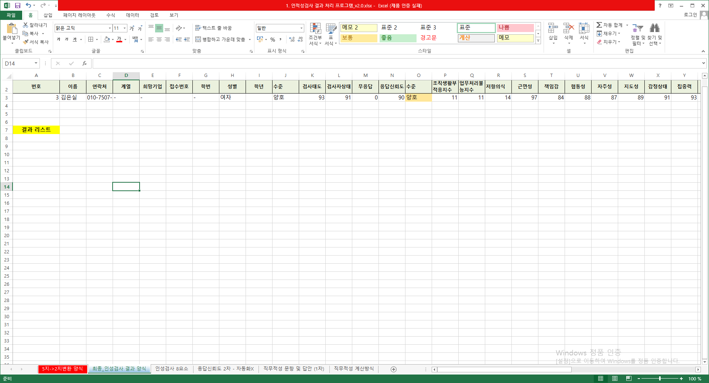
The results of the personality test are available

Slide 8
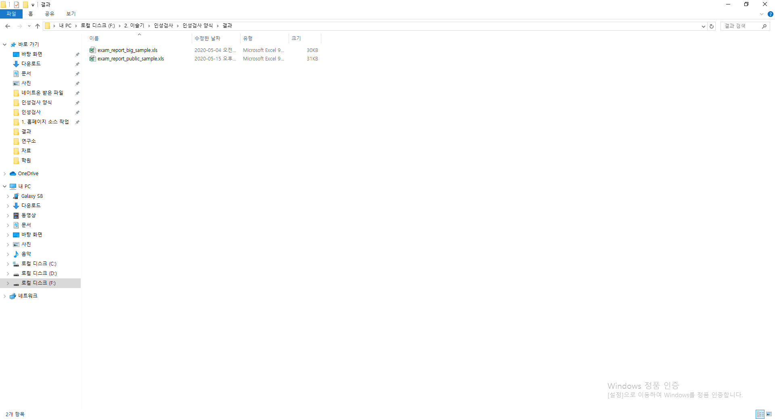
PUBLIC - > Public Company Results BIG - > large company results Paste the personality test results into the correct Excel format

Slide 9
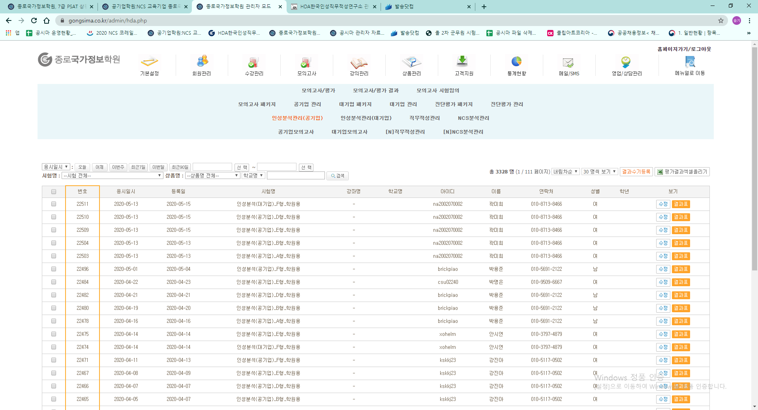
Upload in the format that suits you

Slide 10
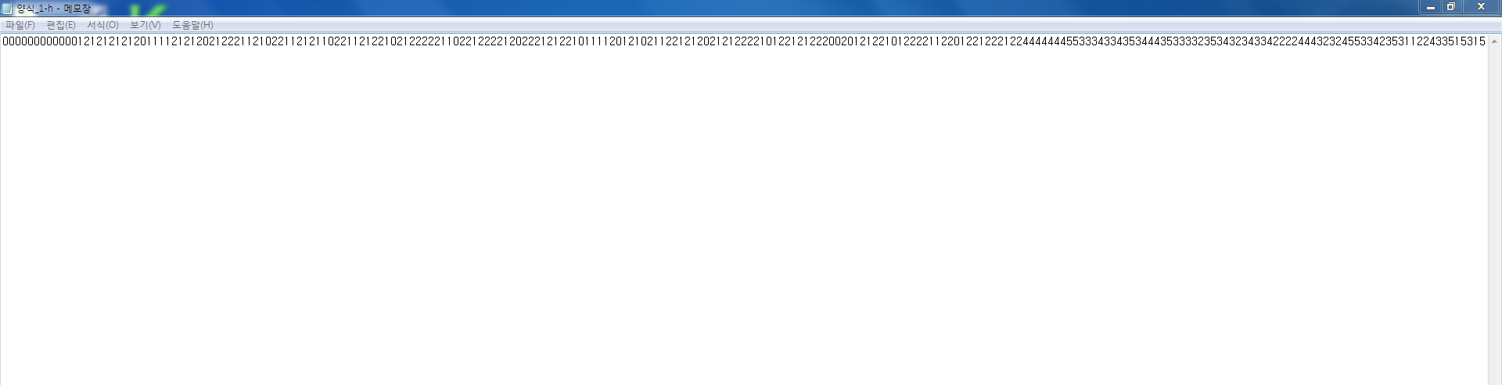
[SidTest 사용방법]
Public Officer Ethics Personality Test A, Public Official Ethics Personality Test B, Public Official Ethics Personality Test C, In the case of a corporate personality test [Using SidTest]
The result is changed afterwards
Because it is an examination number, it is used as it is e.g. 0000000001 = first candidate 000000000002 = Second candidate The storage format is: -h.dat (h.dat is a personality test)

Slide 11
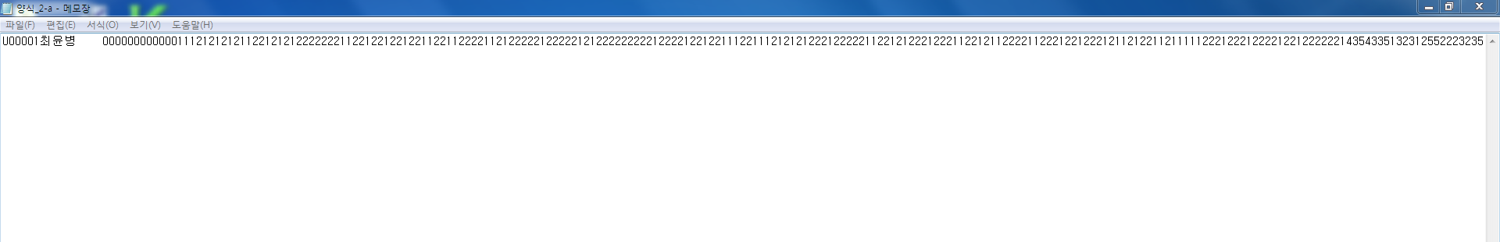
뒤에 결과값은 변경
Because it is an examination number, it is used as it is e.g. U000001Name 0000000001 = First candidate U00002Name 000000000002 = Second Candidate The storage format is: -a.dat (a.dat is aptitude test)

Slide 12
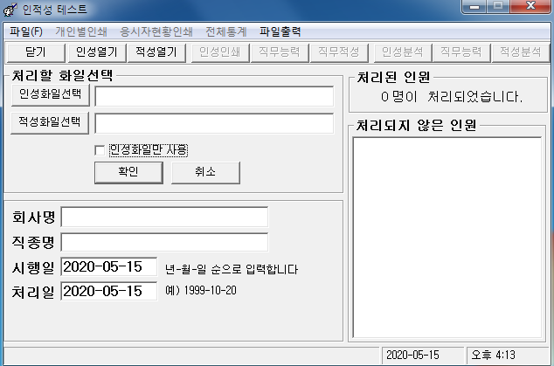
PDF output of personal result table > personality test, aptitude test 2 prints
PDF output of the total statistics table If you are a > company, print (personality test, aptitude test 2 printouts)
H.dat Extension -> Personality Test File Extension
If you are a business, you can print out the candidate's status
a.dat Extension -> Aptitude Test File Extension

Slide 13
How to extract NIFT personality test results
Print the scorecard in Excel and load the value vertically

Slide 14
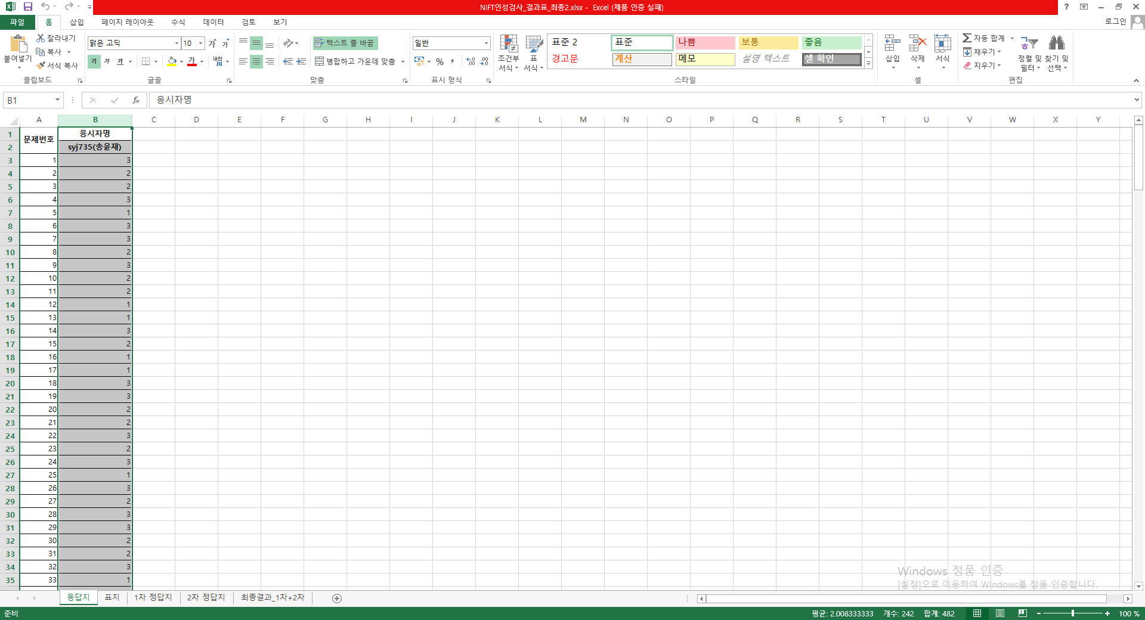
Paste as value

Slide 15
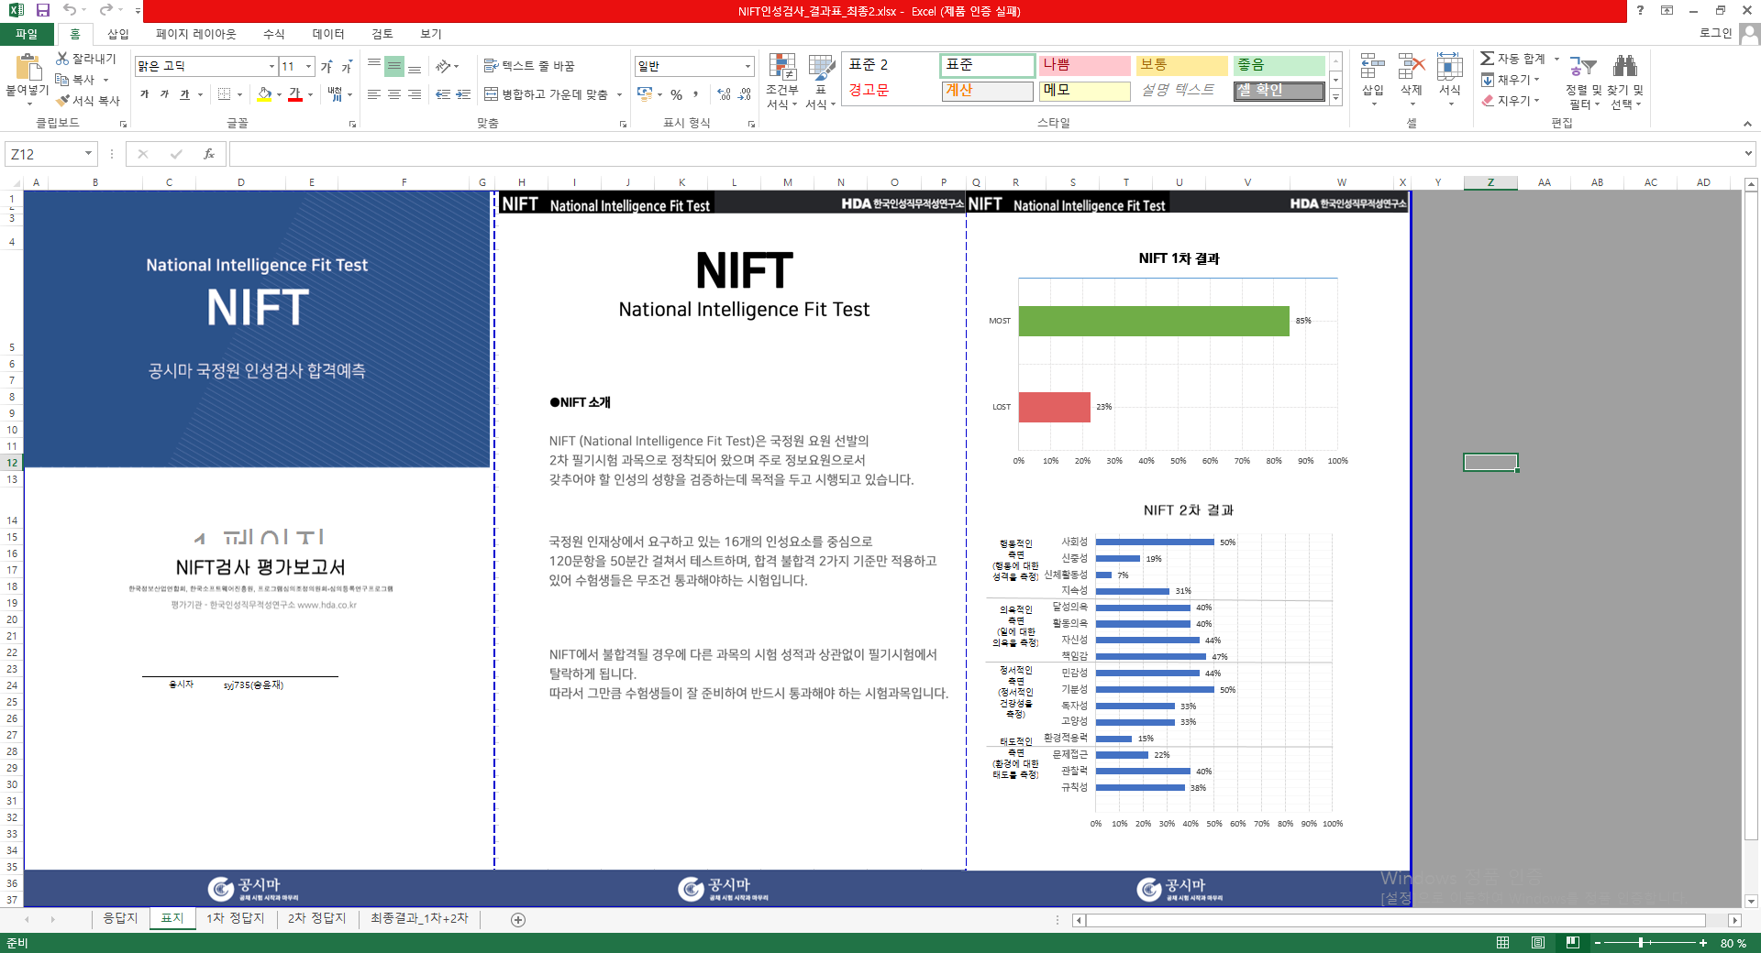
Save as a PDF file

Slide 16
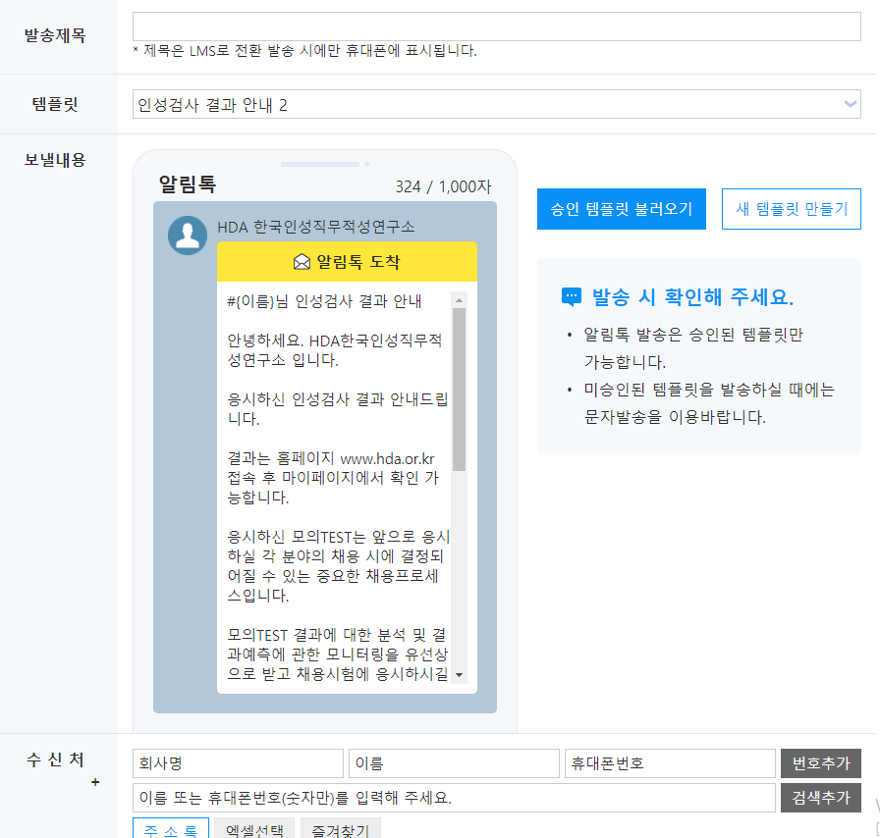
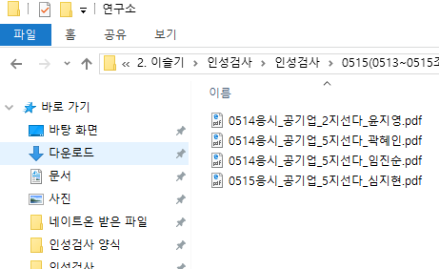
업로드 이후 해야할 것들
연구소 고객에게는 발송닷컴에서 인성결과 메세지 보내기 -> 실장님께 결과지 보내드리기
파일명 : 응시날짜_기업_몇지선다_이름

Slide 17
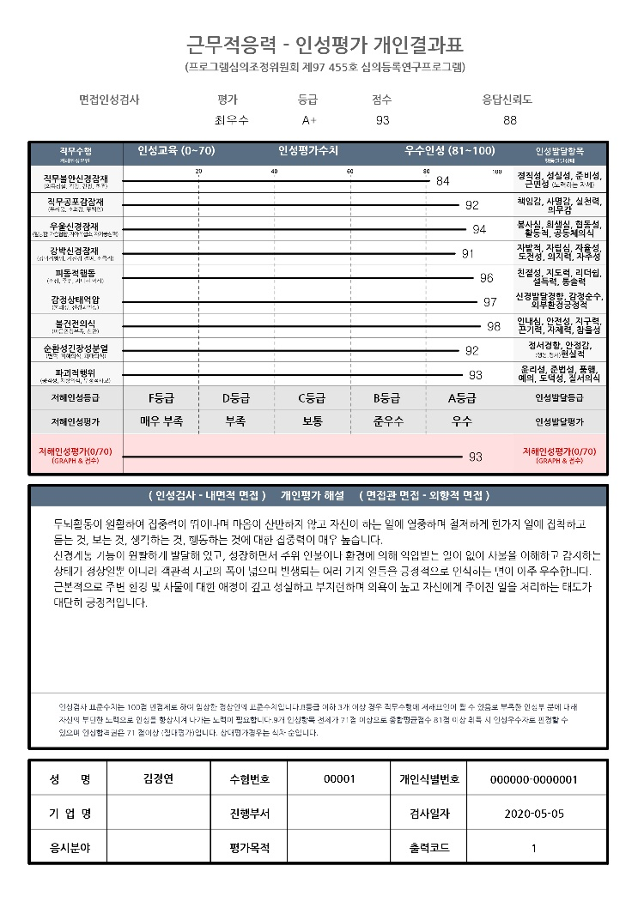
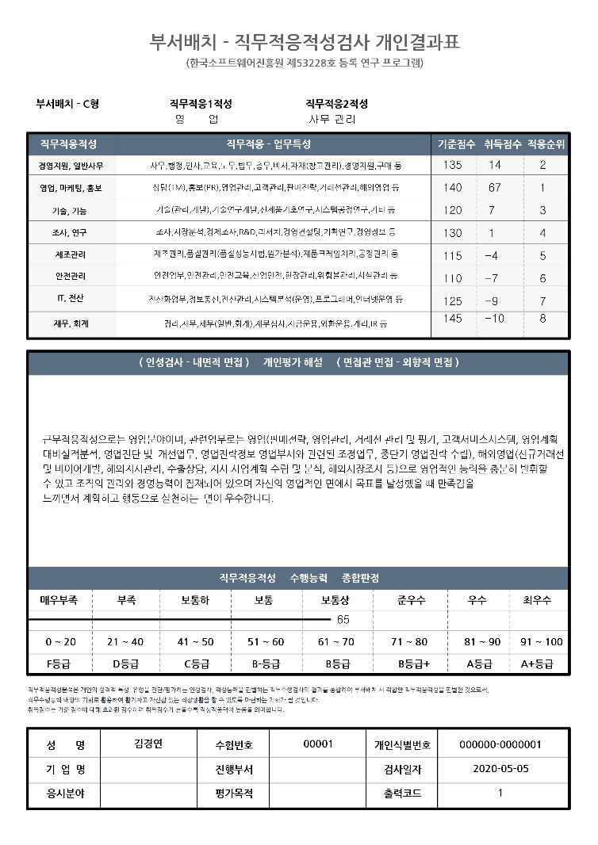
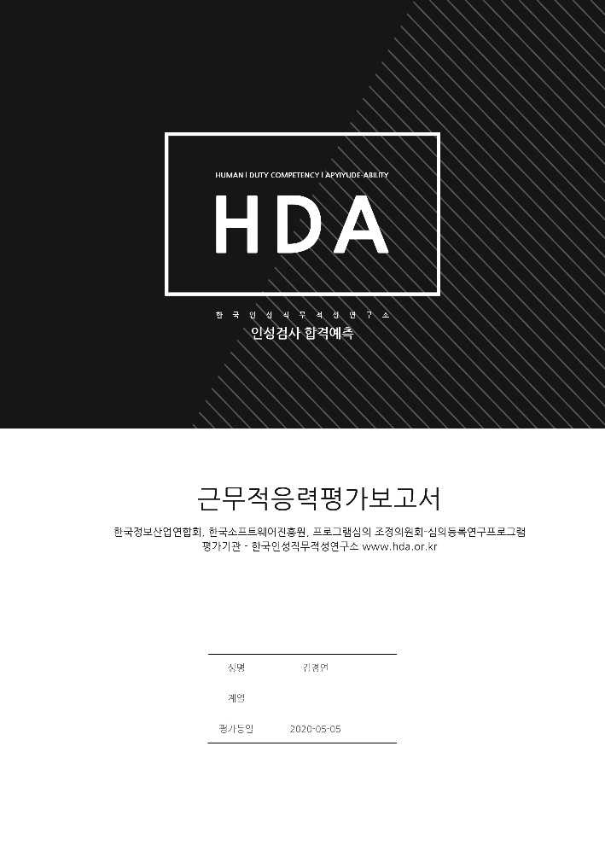
In the case of public official ethics and corporate personality test
Create a PDF file in the order of cover > personality test>aptitude test from the result design Public Employee Ethics Personality Test = Sent by Student Email Corporate personality test = Sent to the person in charge of the company

